Slide 1

QR Payments System
TEAM WD-2
K. Ananya– 20071A05E5 K. Tejaswini– 20071A1225
M. Harikesh– 20071A6629
N. Parthav– 20071A6637
S. Sana Siddiqa-20071A6650
Centre for Presencing & Design Thinking
VNRVJIET
Project Mentor-
J.Sravanthi

Slide 2

Problem Statement
The lack of proper internet connectivity in our college (VNR VJIET) canteen makes it difficult to use UPI. There is a need for a platform through which digital payments can be made even when the user is offline.

Slide 3
Empathy Tool Used-SURVEY
We conducted a survey to understand students experience while ordering food at college canteen.
https://forms.gle/jHd8aQaiuYZ78pqGA
Questionnaire:
Have you ever faced difficulty in internet connectivity at college canteen?
Have you ever been in a situation where you have ordered your food and unable to make a UPI payment due to lack of internet?
If we provide you a service that enables you to make digital payments when you are offline. Do you think it's useful? (services are restricted to college)
It's good to carry money rather than having such a service.
Do you think this application can make your process of placing an order easy?
What features you would be expecting from this application?
User Persona (you can share any of your experience if you have ever came across a situation as described above)

Slide 4
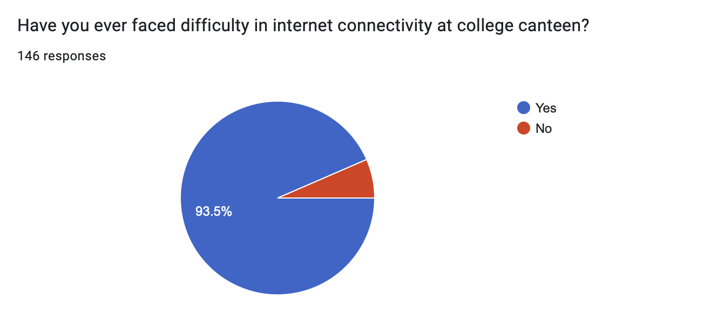
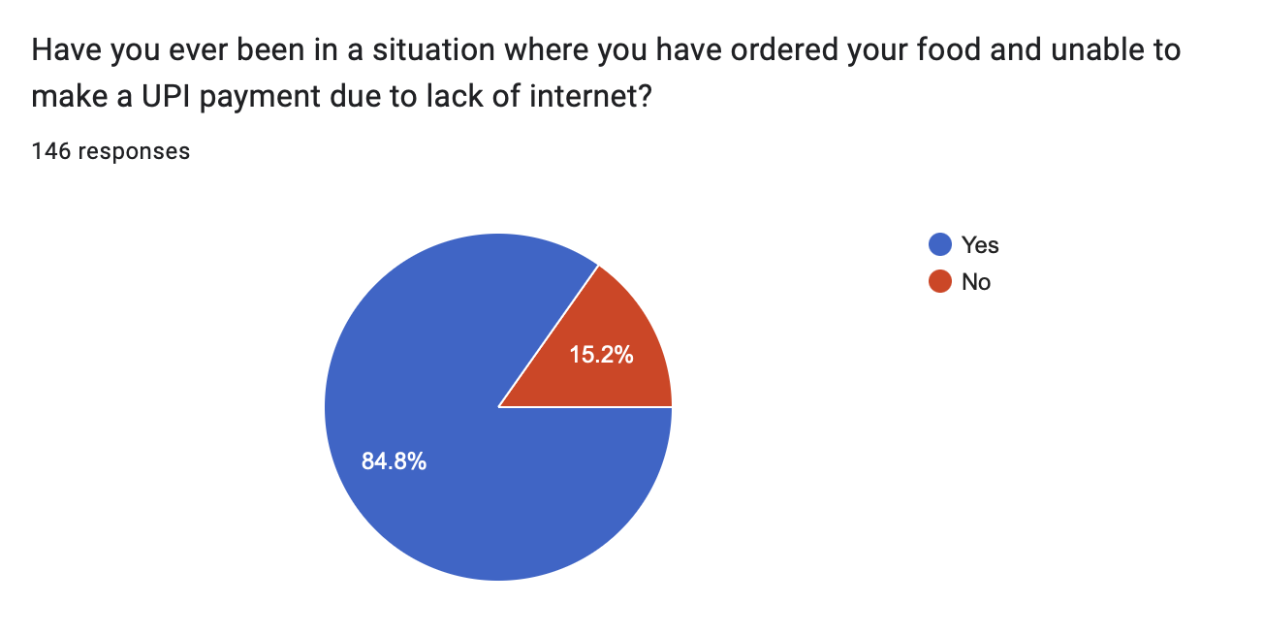
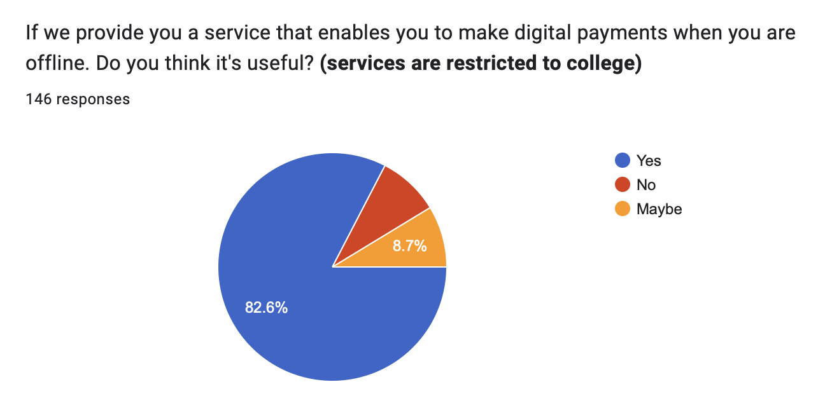
Responses from the survey

Slide 5
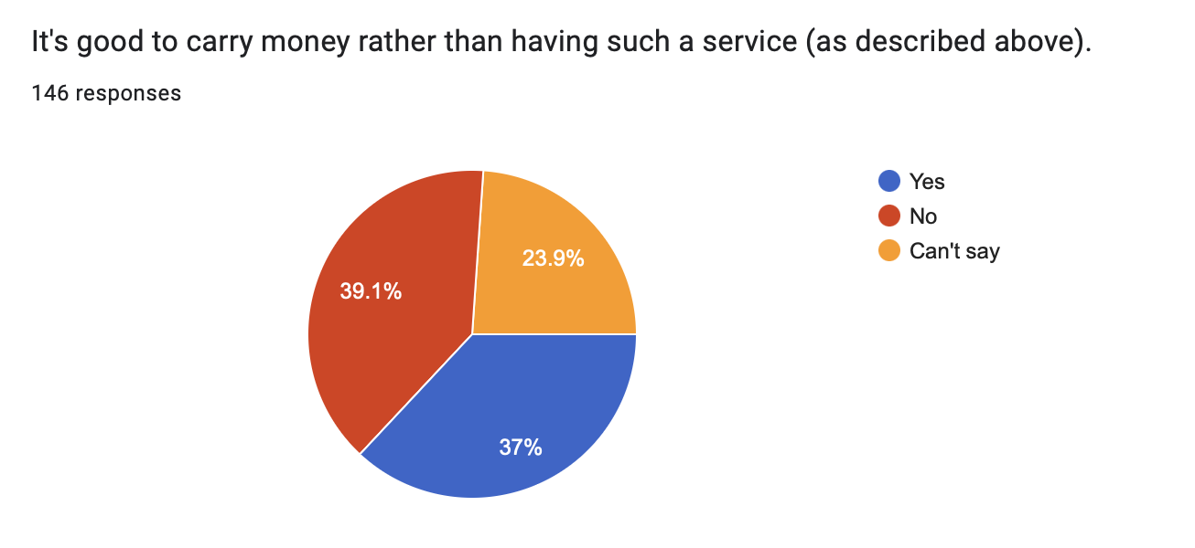
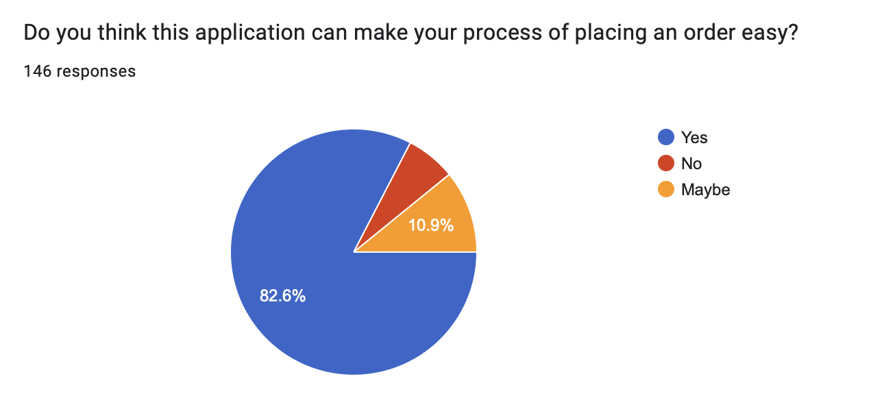
Responses from the survey

Slide 6
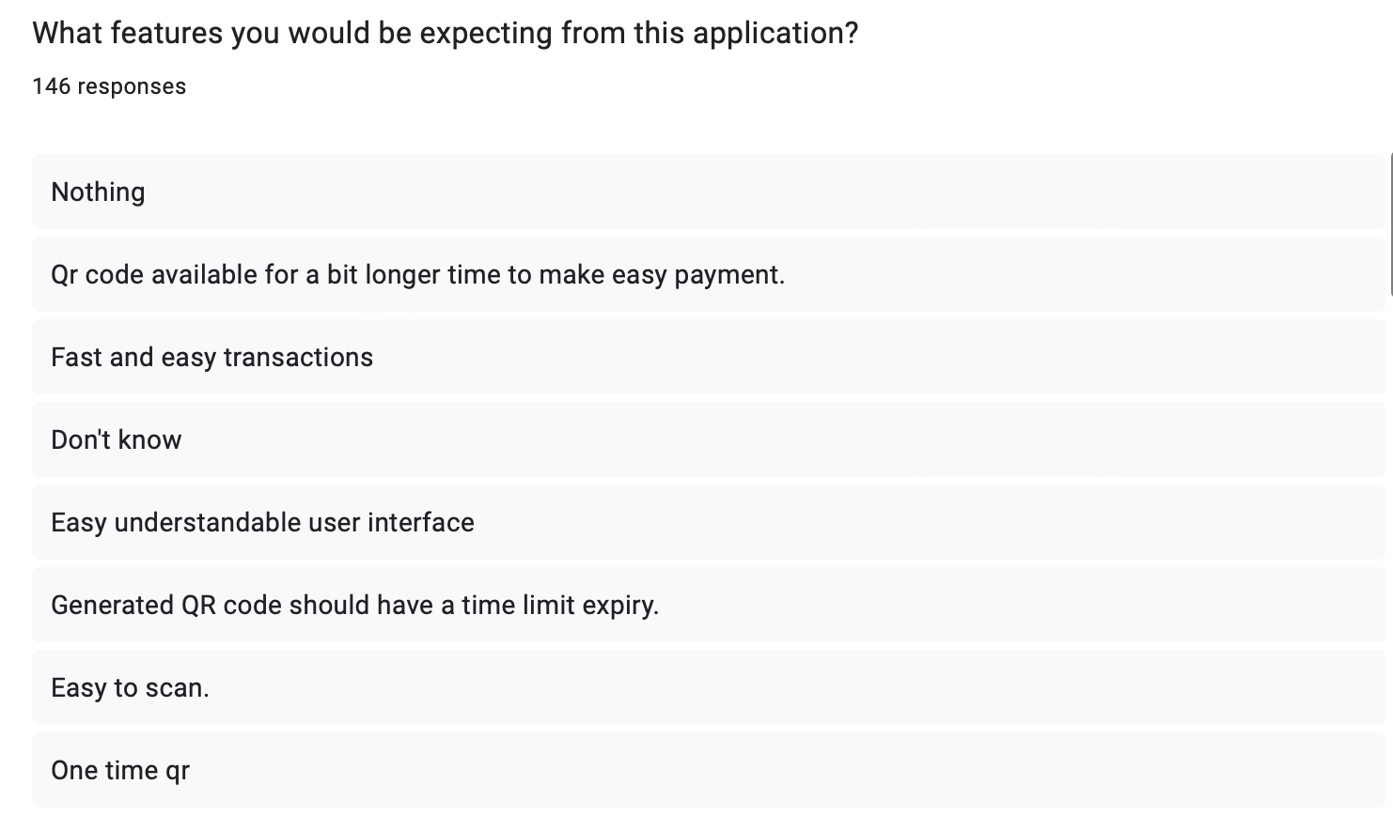
User Requirements / Suggestions

Slide 7
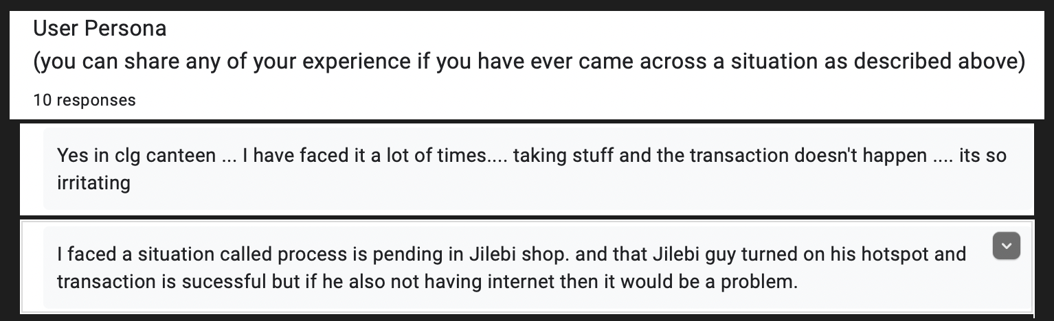
User Persona

Slide 8
Create a persona
Students:
All the students who ever faced trouble in making a payment may find this solution helpful. Students who faced the awkward situation of ordering food and being unable to pay through UPI can relate to this problem.
Vendors:
It becomes easy for the vendors to handle the transactions and keep a note of the order history. This platform helps in the fast completion of the transactions.

Slide 9

Defining Insights
Primary Needs
Make digital payments while offline.
Secure and fast transactions through QR Code.
Interactive User Interface of application.
Secondary Needs
Pin encryption.
Ability to download generated QR Code.
Latent Needs
Generated QR should work for 5 mins.
QR can be used only once.

Slide 10
Service Experience Cycle
Pain Points Address
Students:
Students face some problems during the payments for their food orders.
This application tries to solve these problems by allowing the students to make
offline payments.
Vendors:
This helps in easy analysis of their order history and transactions.
• Vendors can’t have the list of the items ordered by the students for the amount
they received through the UPI.
• This application can be an answer to such problems as we will have the order
history for each transaction.
Gains Expected out of this solution
Students can easily perform digital payments while offline.
• Environment friendly as paper is not being wasted for generating bills.
• Vendors will be benefited due to these fast and easy transactions.

Slide 11
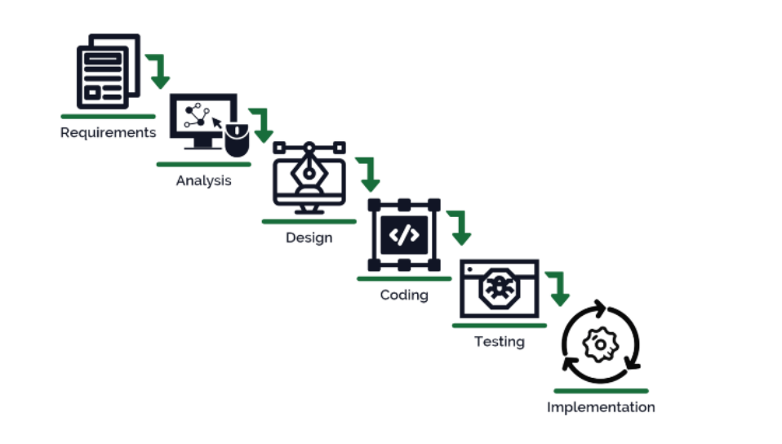
Service Experience Cycle
Task Flow

Slide 12
Ideation Method Used
Brainstorming
The initial ideation of solution was to build an application at the vendor side to take the orders.
This takes huge amount resources and possess high cost of implementation.
After brainstorming we made the ideation of using a QR Code to take orders.
All we need is a medium that carries our information to the machine.
This requirement is fulfilled by using a QR Code.

Slide 13

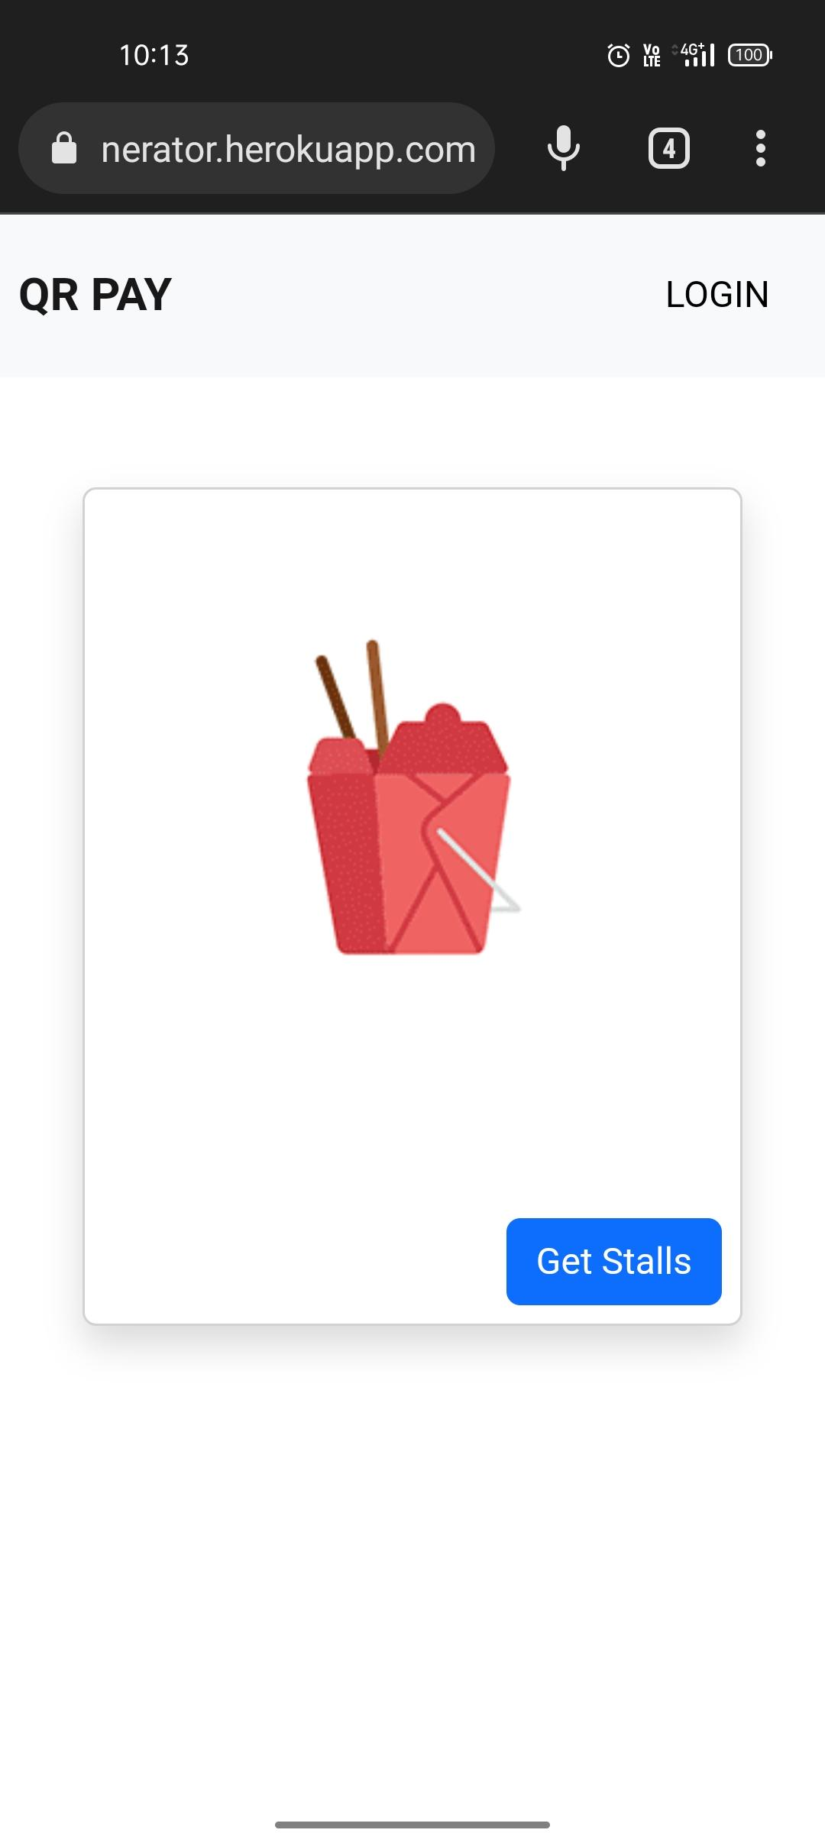
Solution Prototype
The QR Generator App:
Home page:

Slide 14
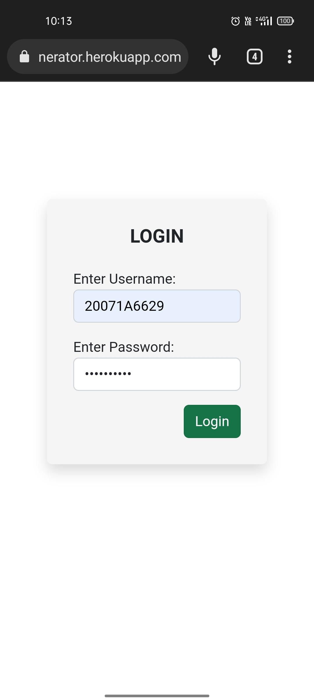
Login Page:

Slide 15
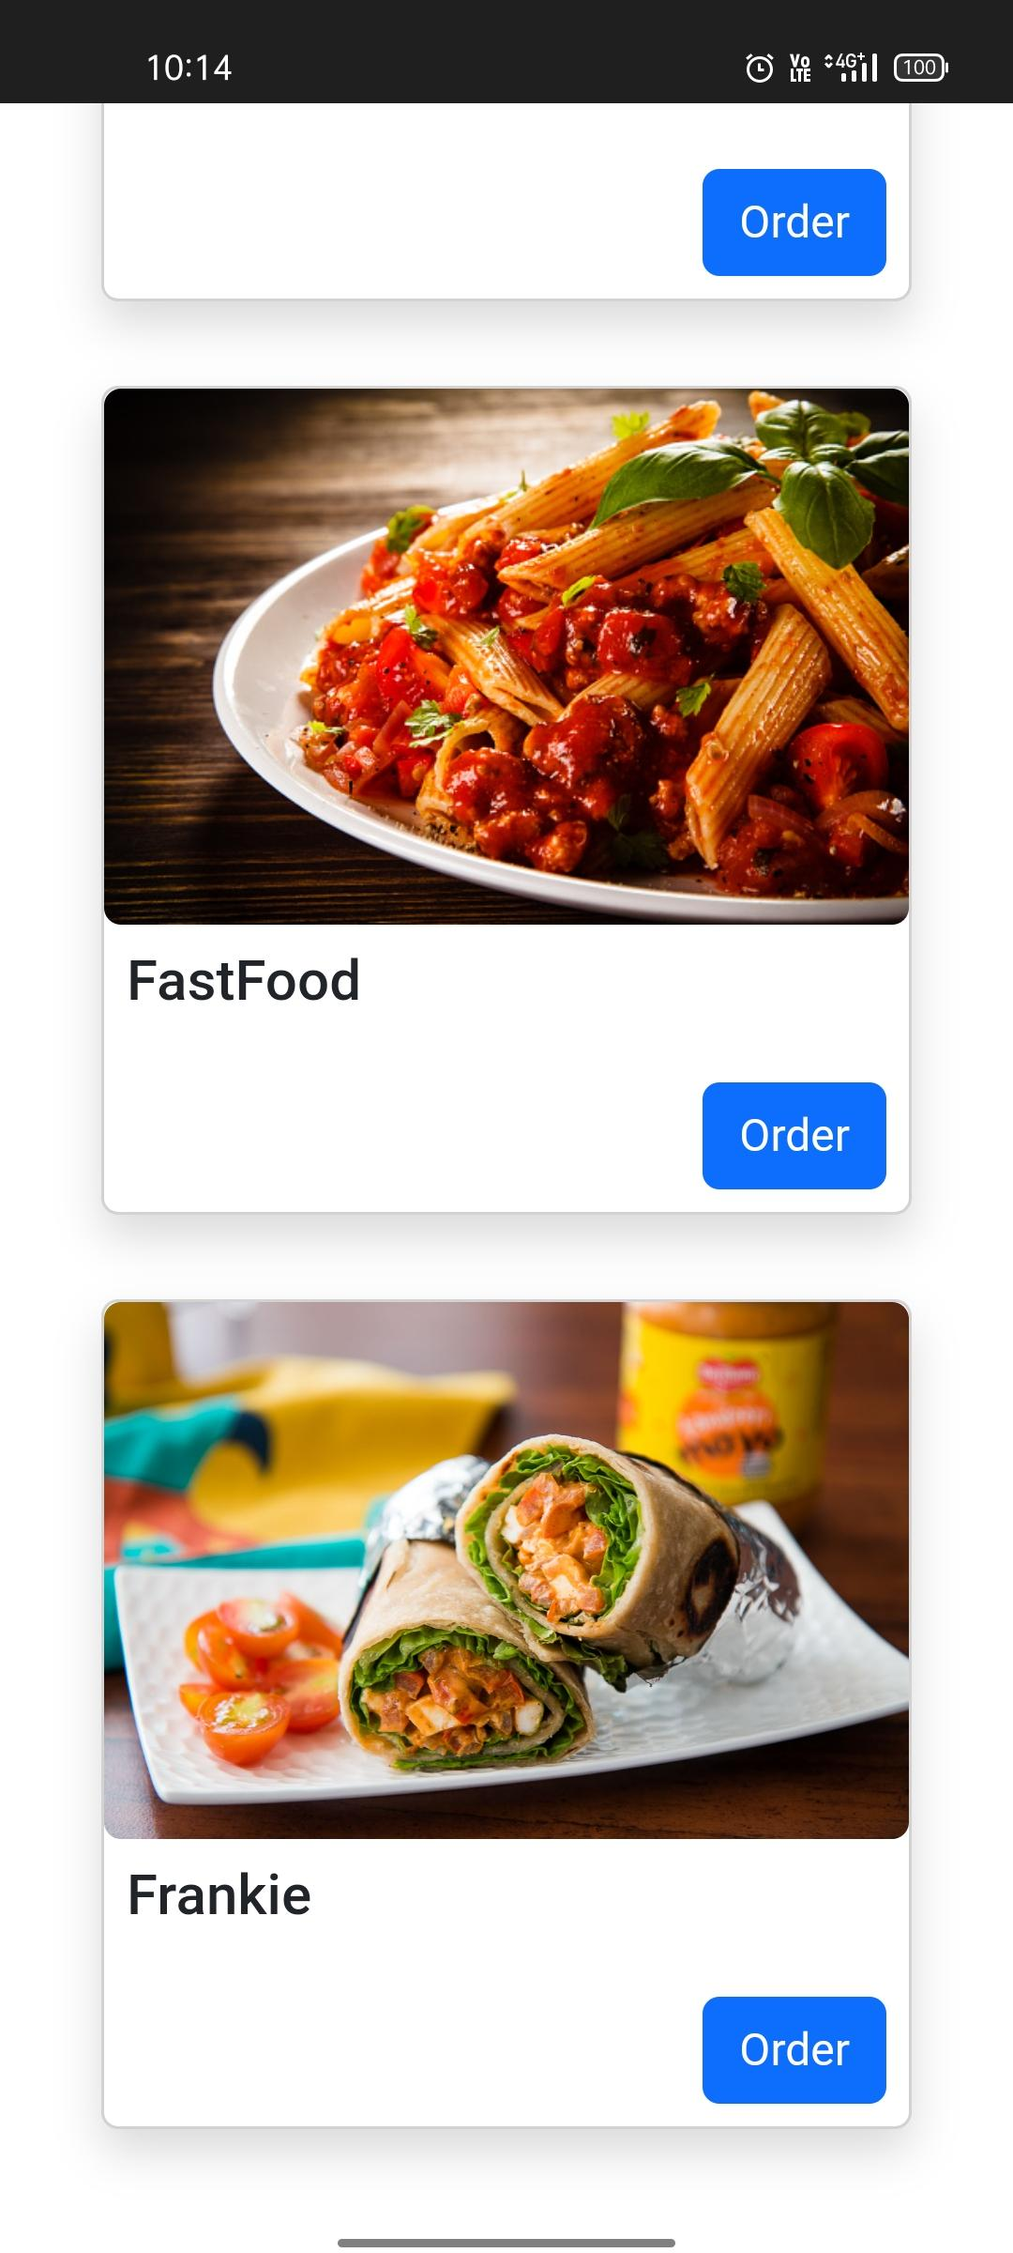
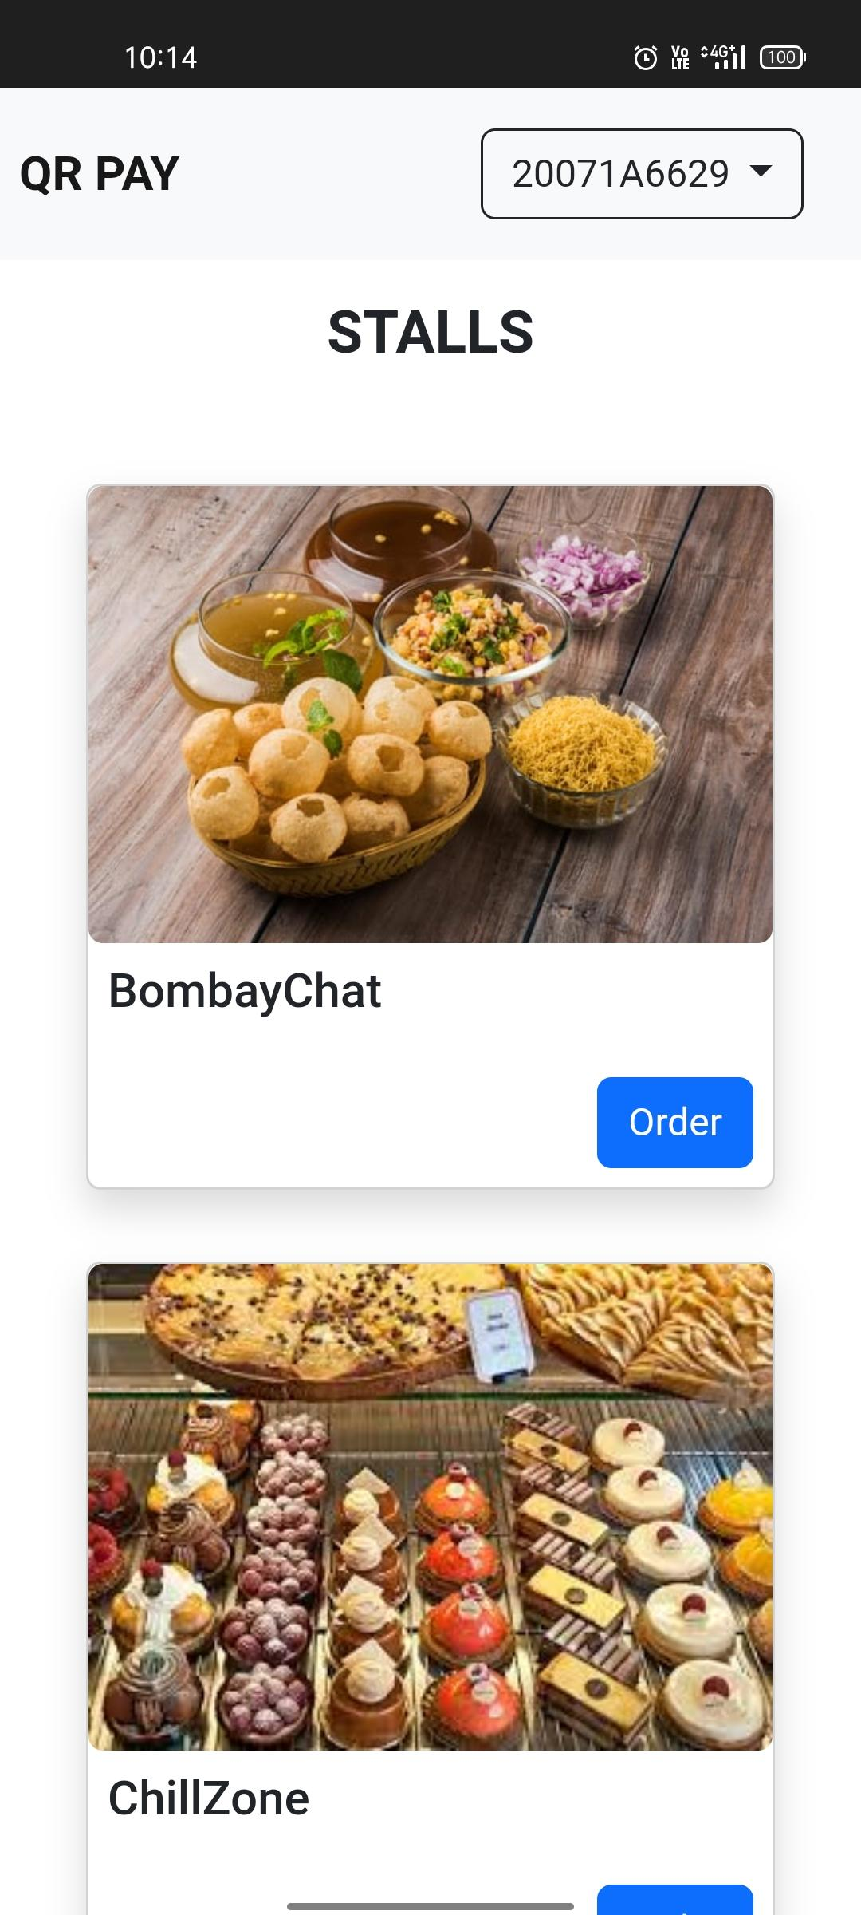
Stalls Page:

Slide 16
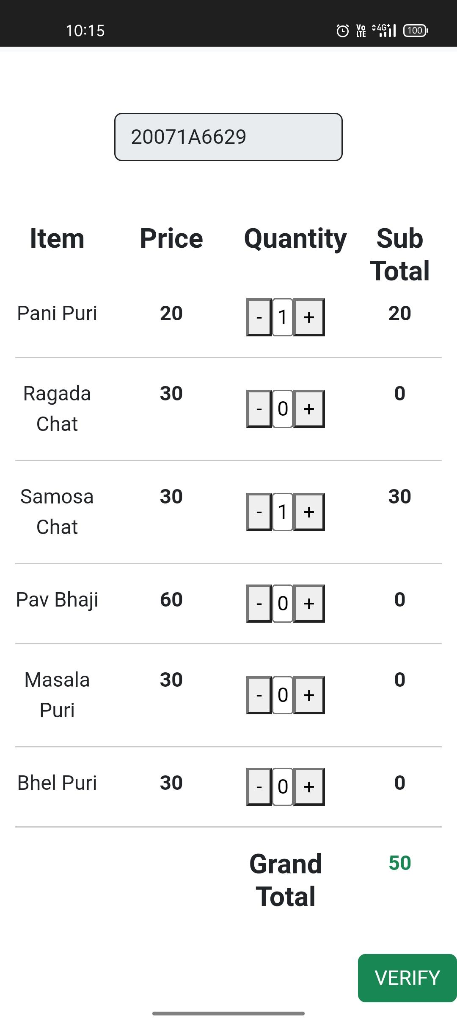
Order Food Page:

Slide 17
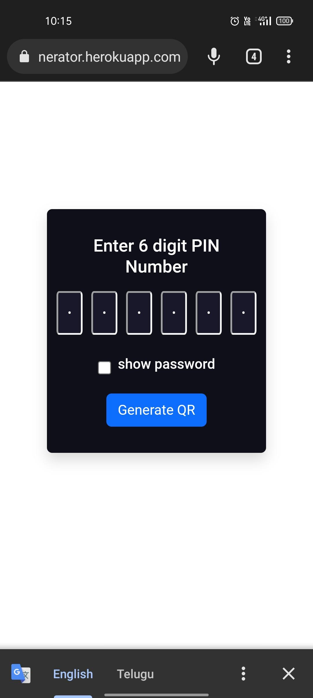
Enter Pin Page:

Slide 18
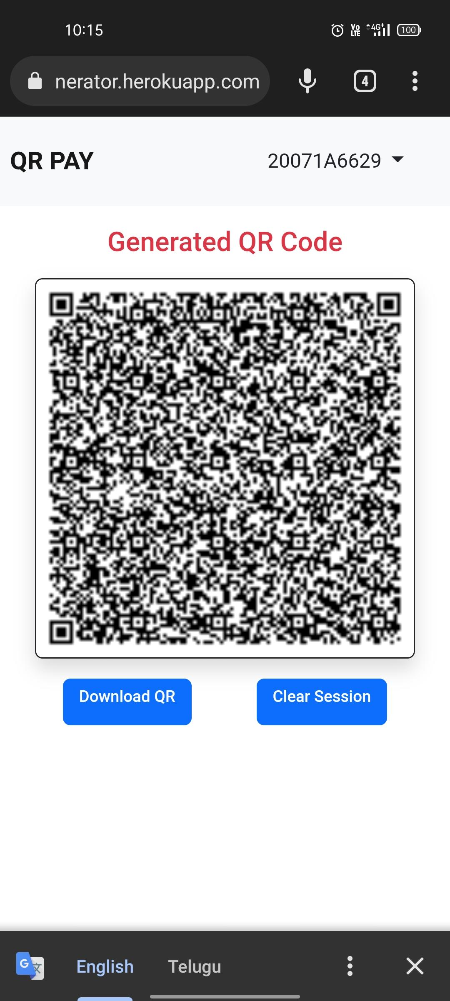
QR Display Page:

Slide 19
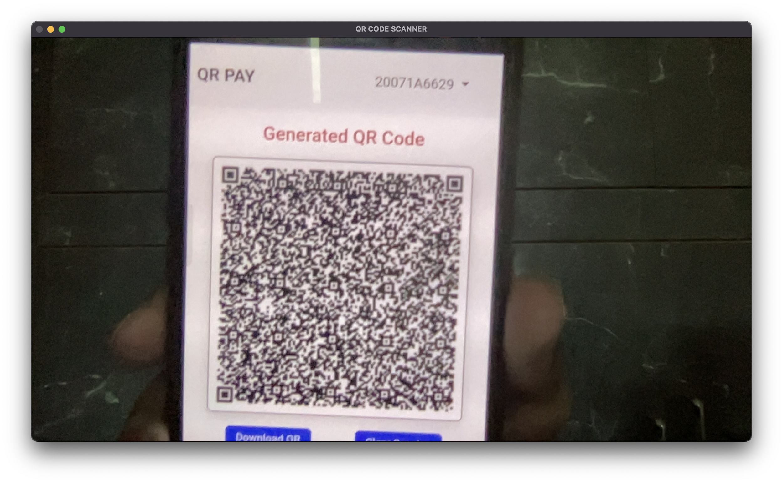
The QR Scanner Module:
QR Scanner:

Slide 20
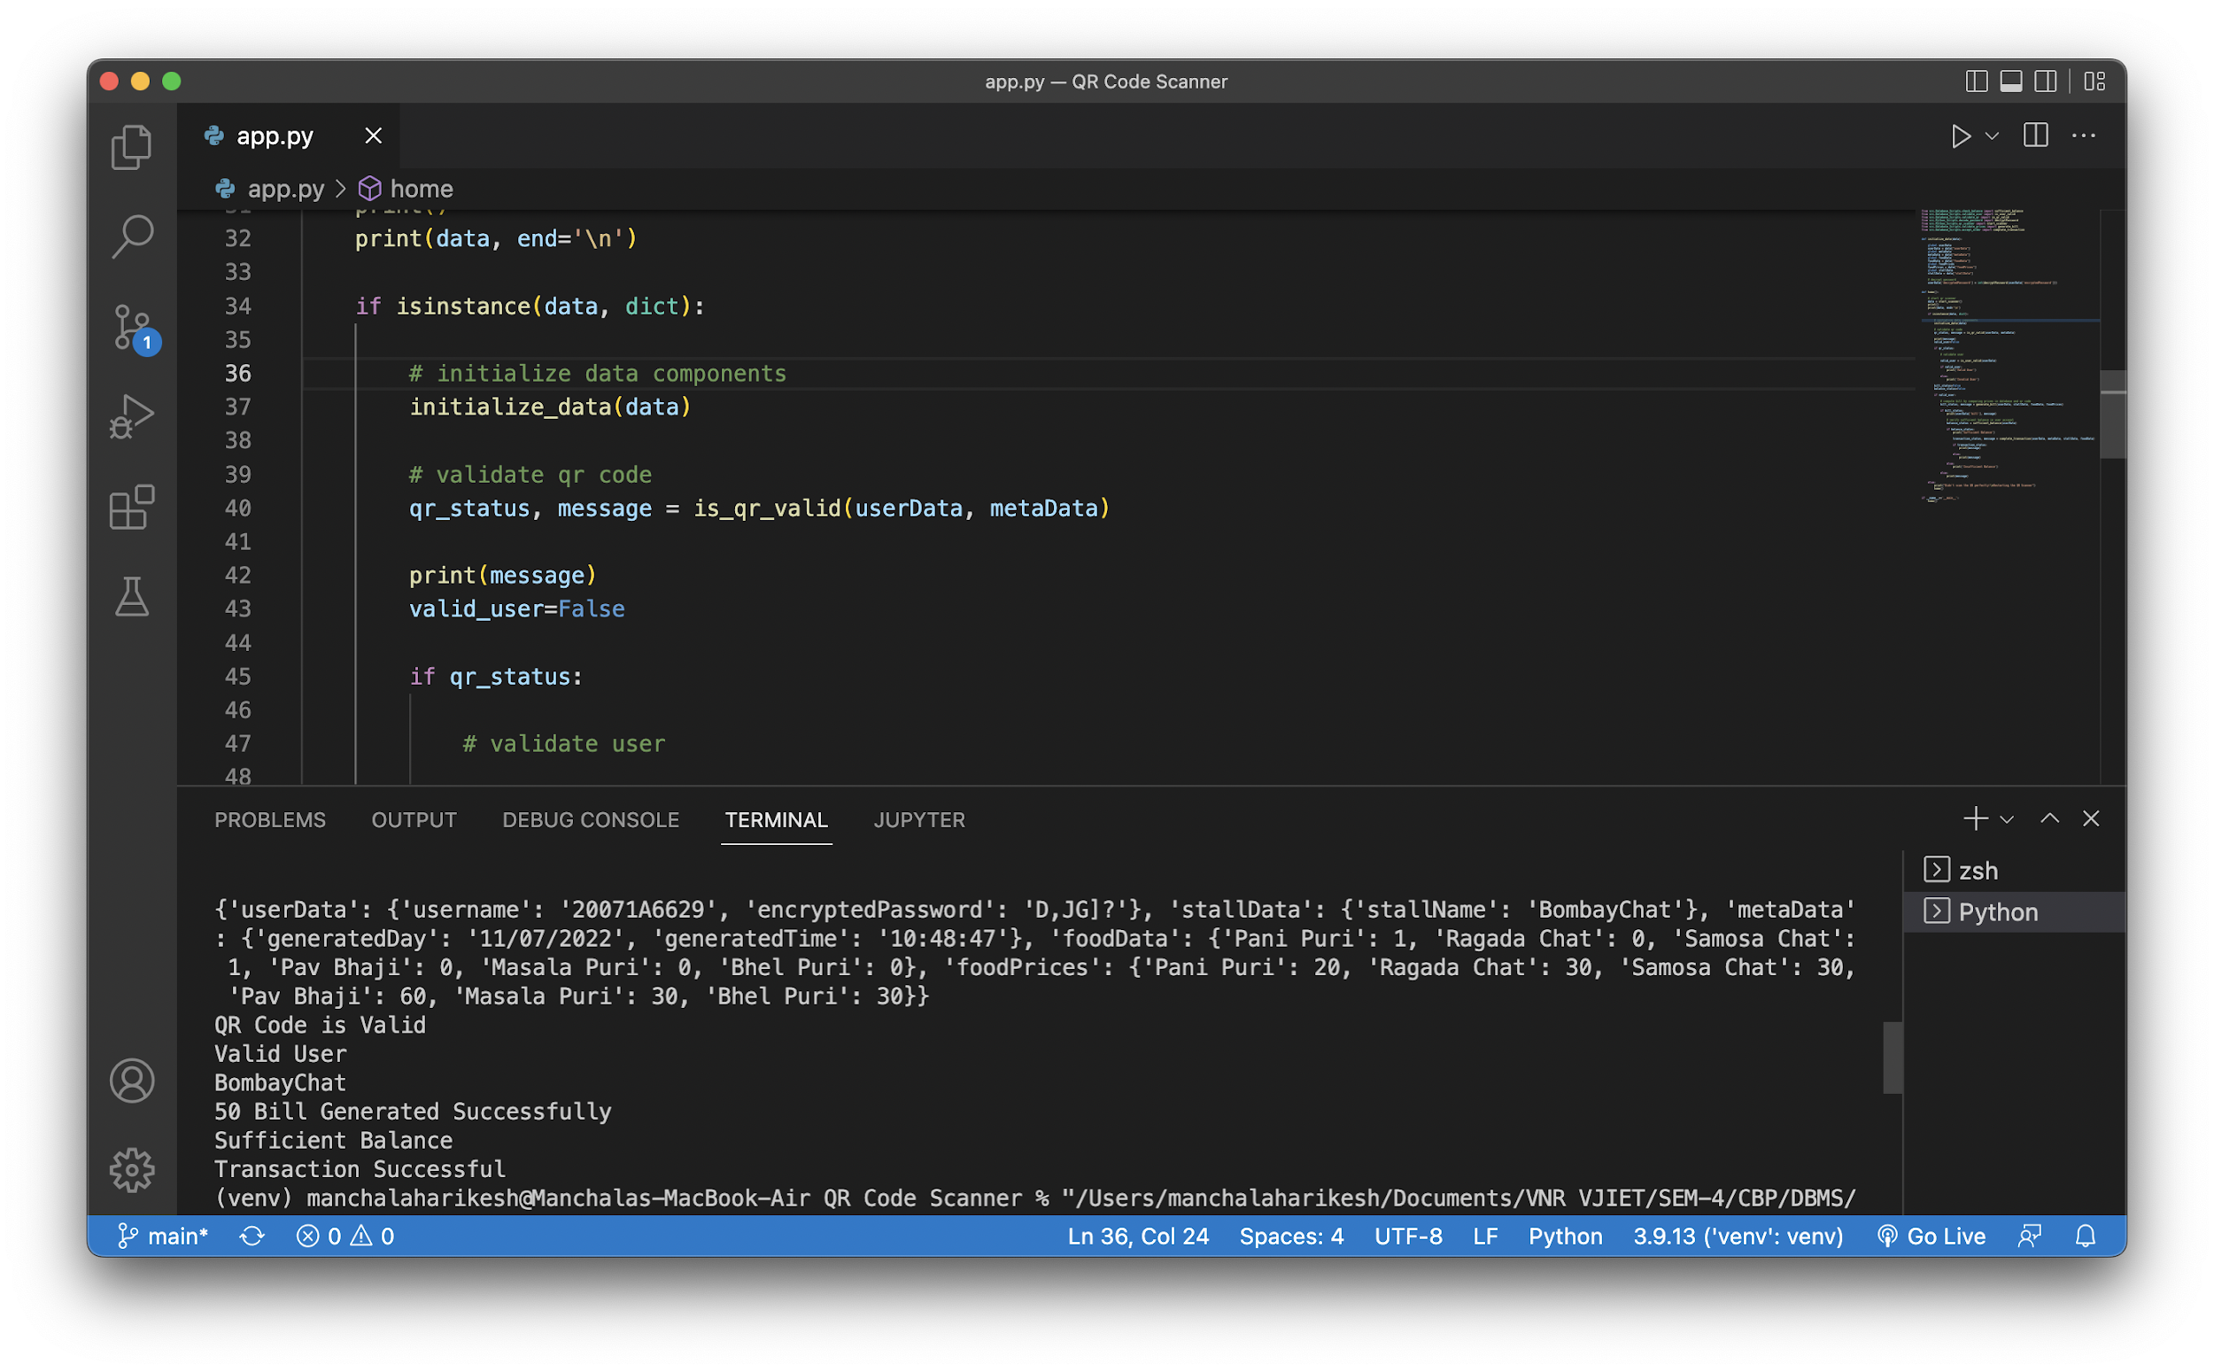
QR Scanner Result (scanning QR for first time):

Slide 21
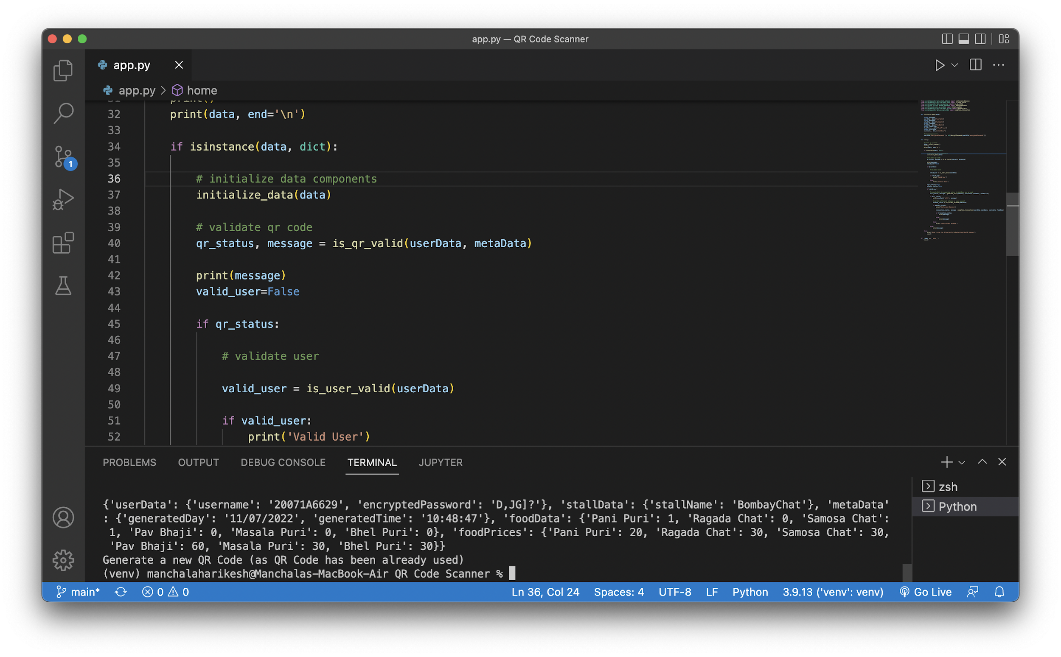
QR Scanner Result (scanning QR for second time):

Slide 22
Encoded Data in QR Code:
{'userData’:
{'username': '20071A6629’,
'encryptedPassword': 'D,JG]?’},
'stallData': {'stallName': 'BombayChat’},
'metaData': {'generatedDay': '11/07/2022’,
'generatedTime': '10:15:32’},
'foodData': {'Pani Puri': 1,
'Ragada Chat': 0,
'Samosa Chat': 1,
'Pav Bhaji': 0,
'Masala Puri': 0,
'Bhel Puri': 0},
'foodPrices': {'Pani Puri': 20,
'Ragada Chat': 30,
'Samosa Chat': 30,
'Pav Bhaji': 60,
'Masala Puri': 30,
'Bhel Puri': 30
}
}

Slide 23
Final Real-Win-Worth
Desirability
The solution we offer is desirable because it solves the desired problem of making a payment even when the user is offline.
This solution is very desirable in the domain we restricted ourselves to i.e., our college canteen.
Viability
Our solution is viable because it overcomes most of the problems faced by the students.
The application built is viable for the users to use as it is built using latest available technologies.
Feasibility
We believe this solution is economically feasible.

Slide 24
Design for Environment
This solution is believed to be very sustainable.
This solution doesn’t harm environment in any means of its usage.
The application infrastructure can be reused by making necessary programmatical changes.
In the aspect of hardware equipment, it won’t wear out easily.
Changes can be made easily that increases its reusability.

Slide 25
Team Experiences
Ananya:
I was able to accept the diversity and learnt how to be more effective and collaborate better.Working on this project was satisfying as this is a problem that is often seen in our college.
Tejaswini:
It was really interesting to work on this topic and I have learnt how beneficial QR payments are.
Harikesh:
Through this project I gained the satisfaction of working on a real life problem which I was empathetically related to.
Parthav:
As a result of this project, I gained a deeper understanding of the online transactional issues students face at our college, and I am glad I was part of a team that proposed an efficient solution.
Sana:
During this project, I had the chance to tackle the ongoing transactional problems caused by the weak internet connection at our college. Working as a team, we were able to devise a practical solution to fix these issues and improve the user experience.

Slide 26
Thank You

